Slide 1


AngularJS.
Forms
NADZEYA SHEDAVA
OCTOBER 23, 2015

Slide 2
COURSE AGENDA
1. INTRO
Angular features
Bootstrap a project
2. CONTROLLERS & MARKUP
Organize code in controllers
Use build-in directives to control view
3. SERVICES
More domain logic to services
Facilitate single-responsibility principle
4. DIRECTIVES
Create own custom elements
Observe changes
Handle events
5. ROUTING
Create true SPA with routing
Use built-in functionality of Angular routing
6. SECURITY
Security scenarios
Work with access tokens
React to 401
Cross-site scripting attacks
Correct bind HTML
7. DEBUGGING & DIAGNOSTICS
Diagnostic and debugging
8. ANGULAR UI
Search for ready solutions
9. FORMS
Enjoy two-way binding
Validate your user input
Show messages
10. TESTING
Test controllers, services and directives
Do full end-to-end testing

Slide 3
MODULE AGENDA
1
Forms
2
Angular validation notes

Slide 4
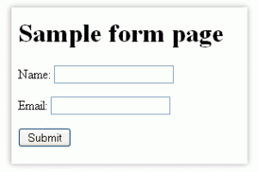
SIMPLE FORM

Slide 5
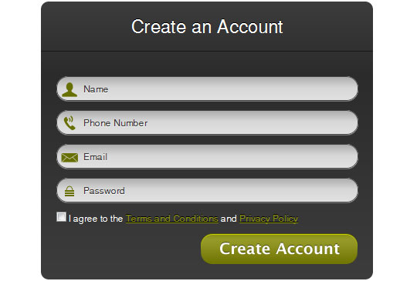
COMPLEX FORM

Slide 6
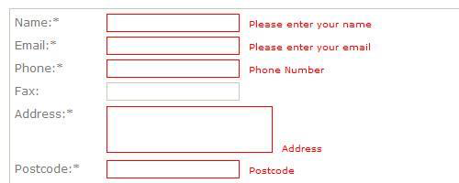
EVEN MORE COMPLEX FORM

Slide 7
ANGULAR VALIDATION NOTES
ng-model
ng-submit
ng-messages/ng-message
give name always
form in forms
ngModelController

Slide 8
NG-MODEL CONTROLLER
https://docs.angularjs.org/api/ng/type/ngModel.NgModelController
require: ‘ngModel’,
link: function(scope, elem, attrs, ngModelCtlr) {
ngModel.$validators.validCharacters = function(modelValue, viewValue) {
var value = modelValue || viewValue;
return /[0-9]+/.test(value) && /[a-z]+/.test(value) && /[A-Z]+/.test(value);
};
}

Slide 9
DEMO
{{ Validation forms }}

Slide 10
Q & A

Slide 11
Thank you
for your attention :)

